Slide 1
Analytics Student Dashboard
Group 2

Slide 2
Introduction
This analysis aims to understand the progress of Students week-wise and the performance of the students in the exams. It is developed to help both teachers and students i.e. Faculty and Students enrolled in particular course in terms of their performance in that course and is useful for maintenance of records as well.

Slide 3
Problem Statement
The problem of the faculty is that they cannot find out student performance and their growth easily so that they can enhance them in it.
Affects - Thus it may affect with final results and career growth of individual from there on.
If the teachers would know which student to focus on every week. They will be able to assist the student better in that particular parameter.

Slide 4
Solution
This analysis helps the instructors to understand which aspect of what student in the class can be cultivated to a better extent i.e . can be improved.
The solution would be a great help to instructors to modify their class delivery. Thereby, Ensuring a successful class.
Students will be able to compete with their peers and understand on which aspects they should focus more.

Slide 5
Tools used
R programming
Shiny App
R studio
Excel

Slide 6
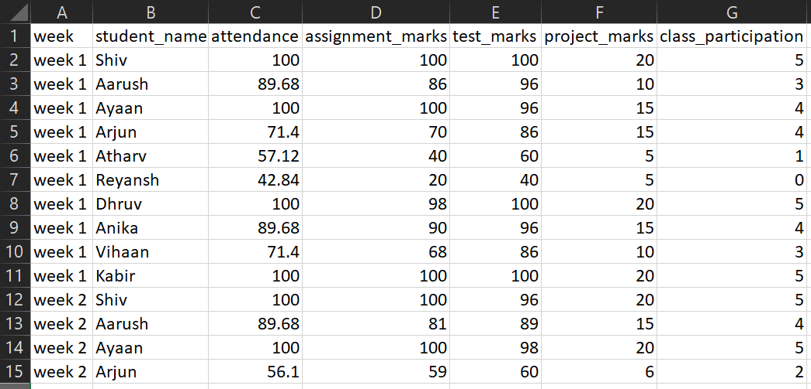
Dataset

Slide 7
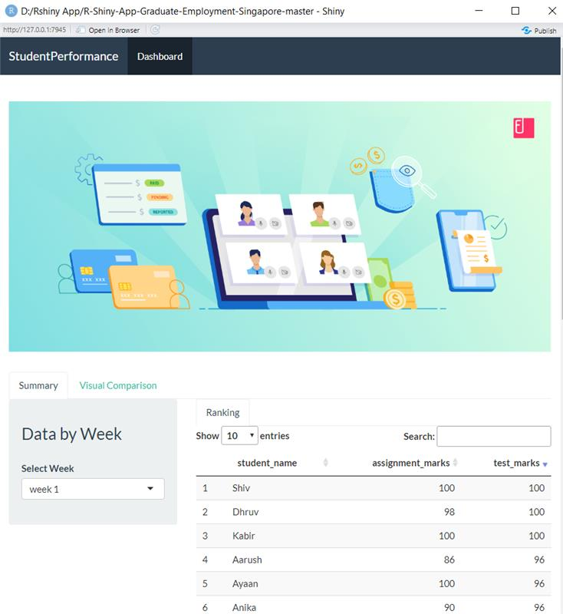
Visual Dashboard

Slide 8
Our Findings
Name | Best Week | Worst Week
Shiv | Week 1 | Week 3
Aarush | Week 1 | Week 4
Aayan | Week 2 | Week 6
Arjun | Week 1 | Week 2
Atharv | Week 5 | Week 1
Reyansh | Week 4 | Week 1
Dhruv | Week 1 | Week 6
Anika | Week 1 | Week 2
Vihaan | Week 4 | Week 6
Kabir | Week 1 | Week 4

Slide 9
Conclusion
Class participation is key, Wherever the class participation is high, Test results will also be high.
Ayaan was the student with the best aggregate score.
Atharv was the student with the least aggregate score.

Slide 10
Roles and Responsibilities of Each Member
Name | Roles and Responsibilites
Shubham (Group Leader) | Data Creation, EDA
Nishchay | R Shiny App (Ui + Server)
Nitish | Data Creation, EDA
Sanchita | R Shiny App ( Ui )
Himali | EDA
Vishnu | R Shiny App ( Server )

Slide 11
THANK YOU

